Slide 1

The Science of Sports Nutrition
PROTEIN 101

Slide 2

PROTEIN AND
THE BODY
Structure
Movement
Immune function
Transport
Hormones
Enzymes
Cell signaling
Notes:
Human body is about 45% protein
The primary function of proteins in the human body are:
Structure – example, collagen
Movement – contractile proteins
Immune function – Antibodies
Transport – hemoglobin
Hormones
Enzymes – facilitate biochemical reactions
Cell signaling, or communication pathways in cells
Energy is not listed here – Protein does provide some energy, but the contribution is very small and not it’s primary role
Some the branched chain amino acids can enter the energy producing pathways. However, providing energy is not one of the primary roles of protein as it is for carbohydrate and fat.

Slide 3
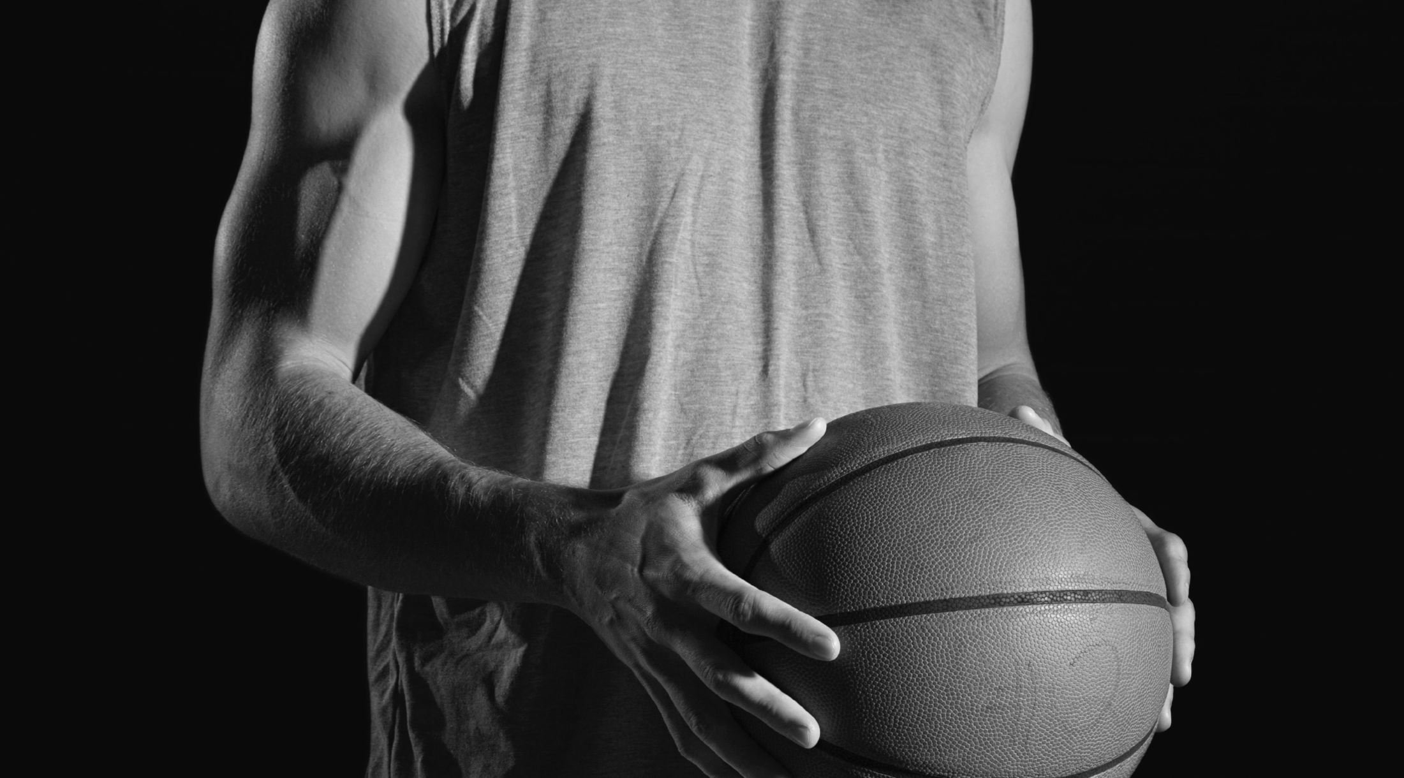



PROTEIN FORMATION
AMINO ACID
nitrogen-containing organic molecule
PROTEIN
AMINO ACIDS BOND TOGETHER
Notes:
Amino acids are nitrogen containing organic molecules, and when they bond together in a chain, a protein molecule is formed

Slide 4


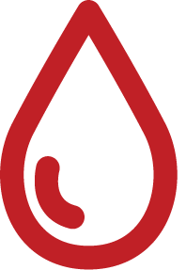
MUSCLE PROTEINS
MUSCLE PROTEIN
SYNTHESIS
MUSCLE PROTEIN
SYNTHESIS
MUSCLE PROTEIN
BREAKDOWN
MUSCLE PROTEIN
BREAKDOWN
AMINO ACIDS
BLOODSTREAM
AMINO ACIDS
(DIETARY PROTEIN)
Notes:
The muscle is always turning over, in balance between muscle proteins synthesis and breakdown. While exercise is often thought of in relation to breakdown, a benefit of exercise is also to increase muscle protein synthesis. But individuals need to deliver amino acids from food since we don’t store them to aid this process

Slide 5
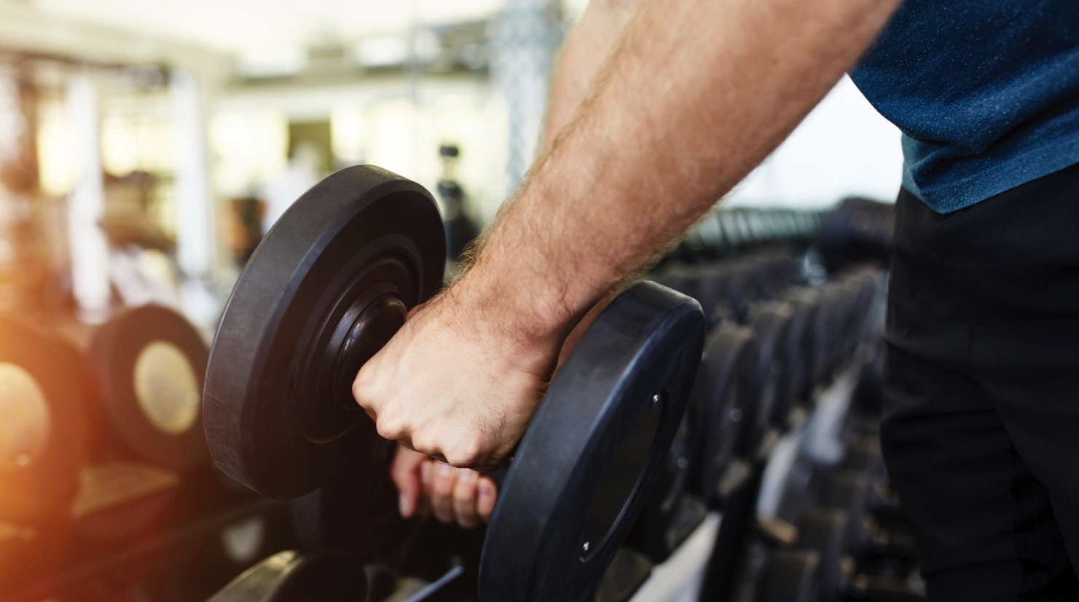

CLASSES OF PROTEINS
ESSENTIAL
NON-ESSENTIAL
CONDITIONAL
Histidine
Isoleucine
Leucine
Lysine
Methoinine
Phenylalanine
Threonine
Tryptophan
Valine
Arginine
Asparagine
Aspartic Acid
Glutamic Acid
Arginine
Cysteine
Glutamine
Glycine
Tyrosine
Ornithine
Proline
Serine
Notes:
There are 3 classes of amino acids
The Non—essential amino acids are produced by the body, so they are not critical to consume in the diet
The essential amino acids cannot be made by the body, so must eat them
The Conditional amino acids are usually produced by the body are are only essential in times of illness
Protein sources that deliver all of the essential amino acids are considered complete proteins

Slide 6
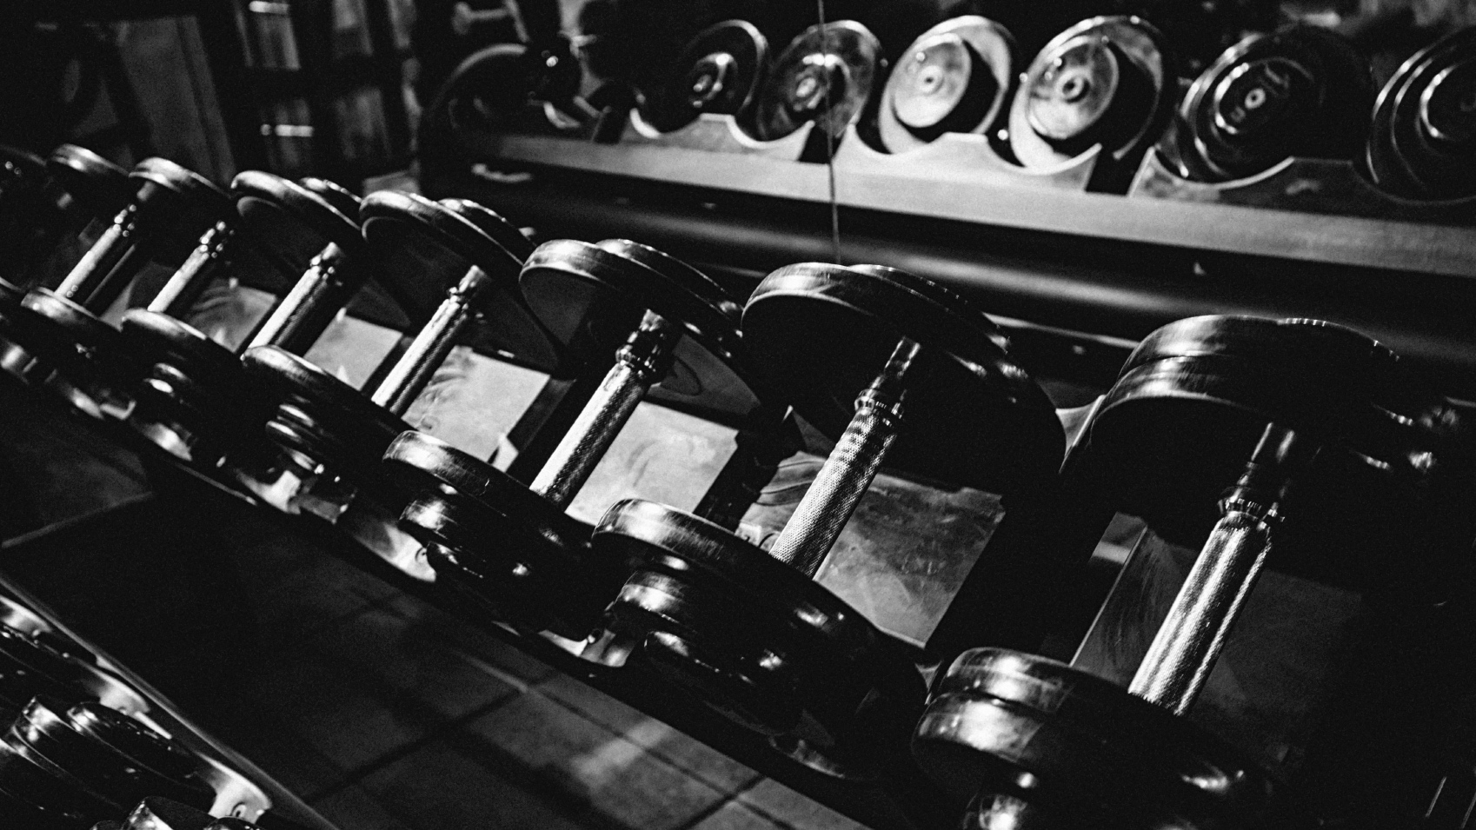


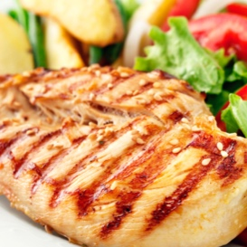
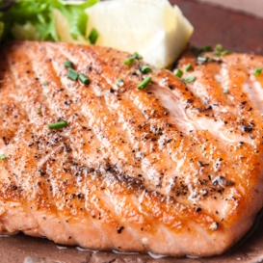
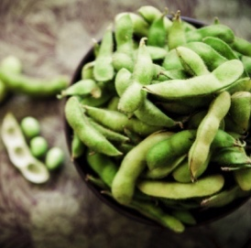
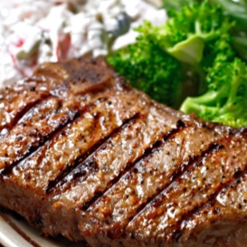
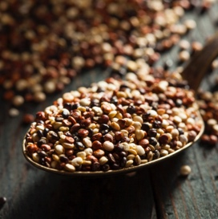
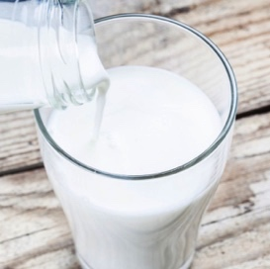
Complete protein sources
CHICKEN
SALMON
SOY
BEEF
QUINOA
WHEY
Notes:
Complete protein sources include poultry, meat, fish, dairy foods (milk, yogurt, cheese, eggs), and soy. Grains are not complete protein sources, with the exception of quinoa
Complete proteins can be obtained by a combination of complementary sources, such as rice and beans. Vegetarians athletes need to be vigilant about their complementary sources of protein to ensure they meet their daily needs of complete proteins.

Slide 7
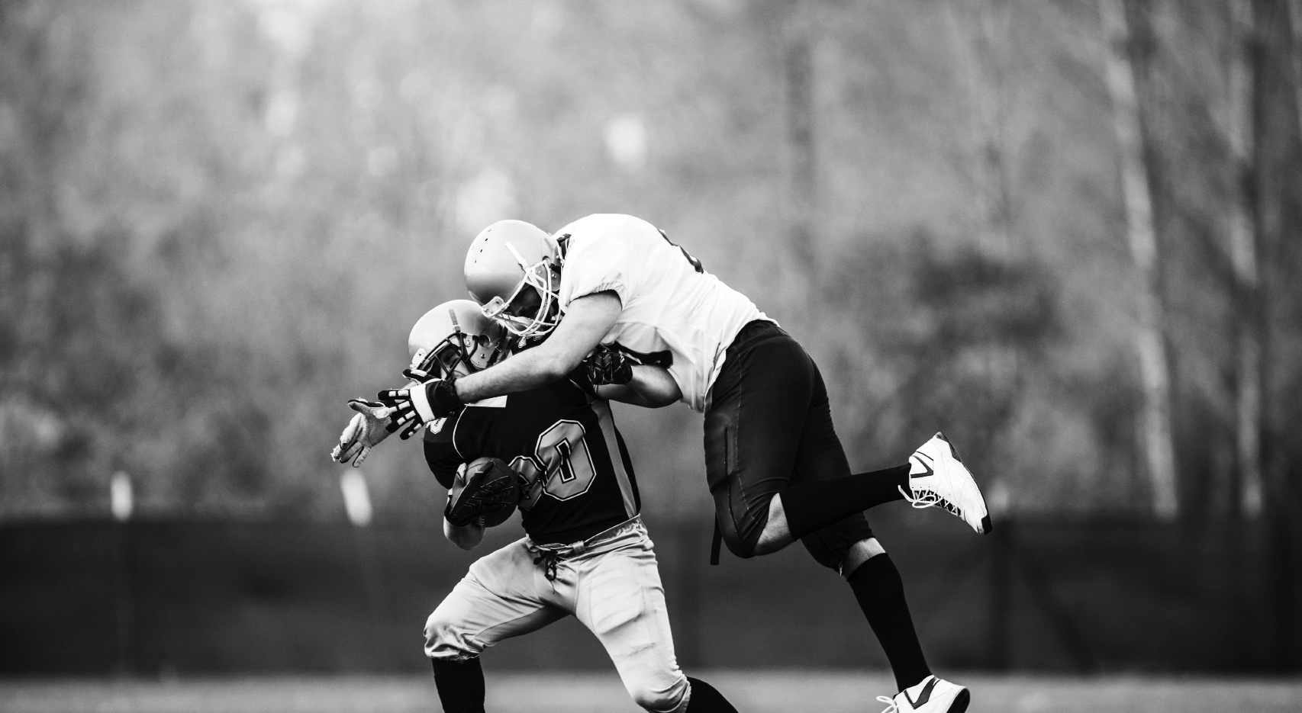


DAILY INTAKE GUIDELINES
Recommended dietary allowance: 0.8 g/kg/d
ATHLETE NEEDS: 1.2-2.0 g/kg/d
PROTEIN
TURNOVER
REPAIR
REMODELING
METABOLIC ADAPTATION
Slater & Phillips. J Sport Sci. 29(Suppl 1):S67-77, 2011.; Stellingwerff et al. J Sport Sci. 29(Suppl 1):S79-89, 2011.; Packer et al. Front Nutr. 4(64):1-8, 2017.
Joint Position Statement: Nutrition and Athletic Performance. Med Sci Sports Exerc. 48:543-68, 2016
Notes:
The recommended dietary allowance for adults is 0.8 g/kg/day, which is about 0.4 g/lb, or 58 g of protein for a 160 lb individual. But remember this is the minimum, not optimum
Due to increased demands of exercise, the recommended intake for athletes is slightly greater than the RDA for adults, the amounts depending on the type of athlete and their goals. The protein intake supports metabolic adaptations to training, repair, remodeling, and protein turnover.
Even higher intakes may be indicated during periods of intensified training or when energy intake is reduced.
The broad recommendations cover most training regimens and allow for flexible adjustments due to periodized training and conditioning, allowing the practitioners to tailor the recommendations to the individual athlete.
However, while the recommendations are higher for athletes, the majority of athletes have no problem meeting these numbers and do so on a regular basis.

Slide 8
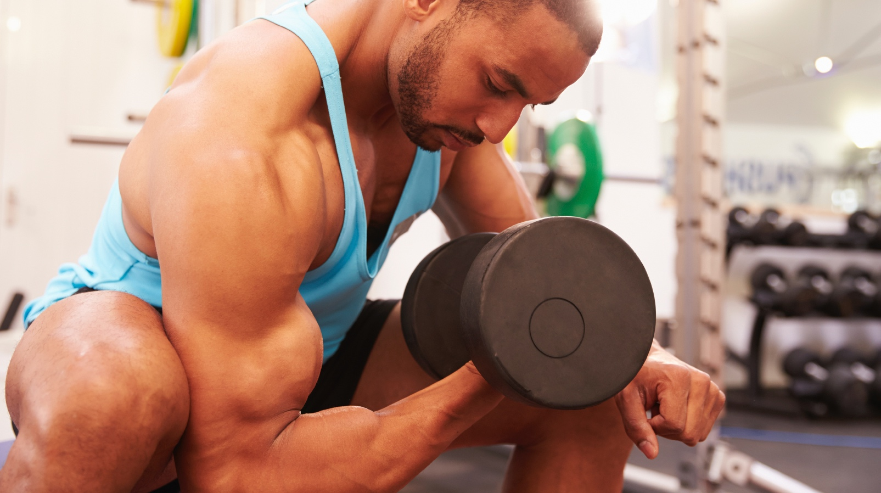
SPORTS NUTRITION AND PROTEIN FOR RECOVERY:
Provide the amino acid substrates to promote MPS
Notes:
Primary role of protein in sports nutrition is for recovery to provide the muscle with amino acid substrates from proteins while blood flow is increased and the hormonal environment is anabolic, or promotes protein synthesis.
Recovery protein will help to rebuild any muscle fibers broken down during exercise. However, while consuming protein acutely after exercise is an important behavior, it is important to remember that muscle rebuilding doesn’t happen immediately.
The main benefit of regular recovery protein ingestion is to maintain muscle mass or build bigger muscles, depending on the training program and goal.

Slide 9
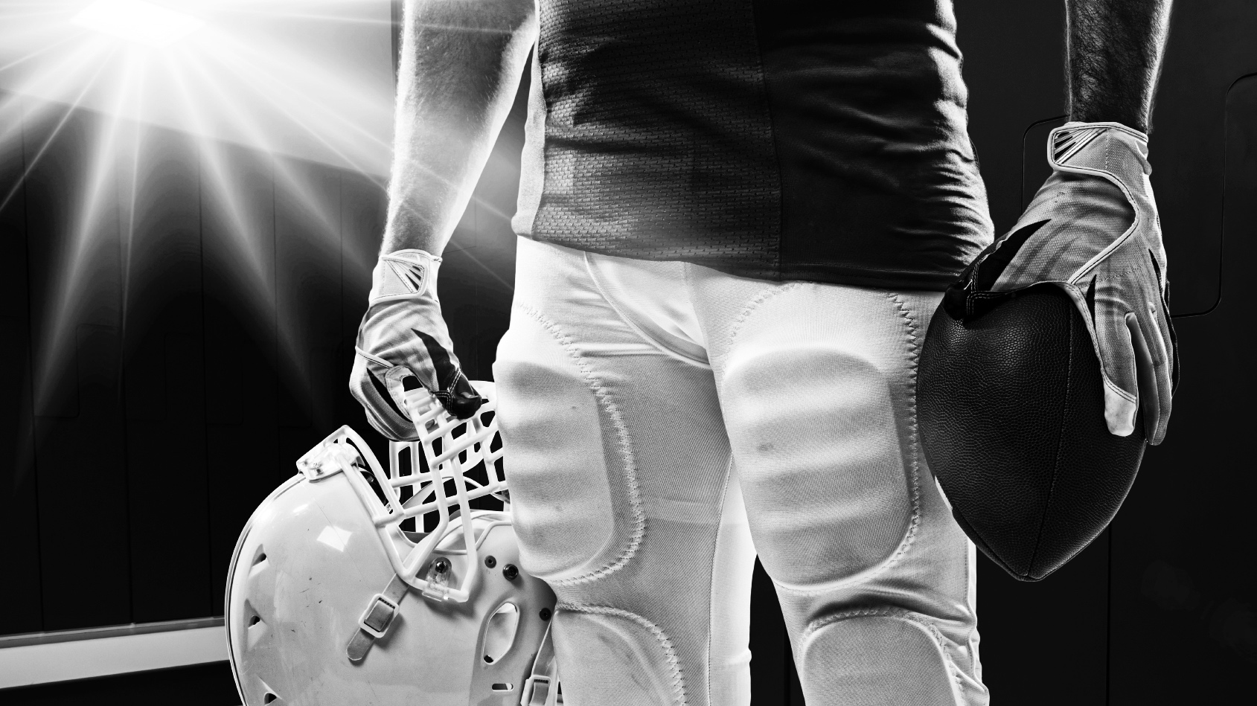



Protein is more than a quick fix
IN-SEASON, TEAM SPORT
PERFORMANCE
OFF-SEASON
INCREASED MUSCLE MASS
DAY TO DAY
SEASON
ADAPTATION
CHO
H2O
NA+
PROTEIN
PROTEIN
Notes:
An example of the role of protein in relation to other recovery nutrients. The main point is that while protein should be consumed regularly, the benefit is really long term

Slide 10
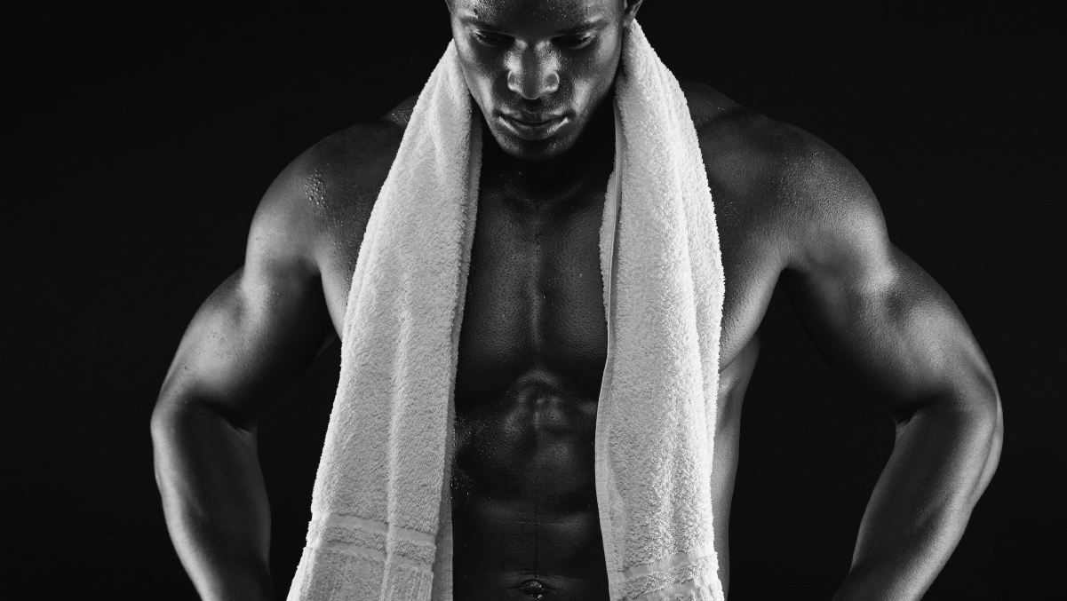


Amount
Timing
Type
Incorporating protein into a sports nutrition recovery plan
Notes:
We need to consider the amount of protein to consume, when to consume it, and what type
Amount:
How much protein to be effective?
How much is too much?
Timing:
What is the best time after exercise to eat protein?
Type:
Which source of protein is most beneficial for recovery?

Slide 11

How much protein is needed post-exercise?
.15
.11
.08
.04
.00
Muscle Protein Synthesis
Muscle Protein Synthesis
0
10
20
30
40
50
0
10
20
40
EGG PROTEIN (g)
WHEY PROTEIN (g)
Moore et al. Am J Clin Nutr. 89:161-168, 2009.
Witard et al Am J Clin Nutr. 99:86-95, 2014.
Notes:
To determine the amount of protein needed after exercise, researchers at McMaster University conducted a dose-response study. In this study subjects consumed a placebo, 5, 10, 20, or 40 g of egg protein after a bout of resistance exercise, and the rate of new protein synthesis was measured. 5 and 10 g were both better than placebo to increase muscle protein synthesis, 20 g was even better, but at 40 g there was not a further increase.
Based on this data, the authors concluded that about 20 g of a complete protein is the right amount to stimulate muscle protein synthesis after exercise.
It is important to note that the subjects in this study averaged about 189 lbs. Smaller athletes may need a little less than 20 g, larger athletes may need a little more, but right around 20 g is the target for most athletes. If an athlete wants to figure out their protein needs based on body weight, they can estimate by multiplying their weight in kilograms by 0.25.
Witard study confirms 20 g recommendation, but with whey protein, and after eating breakfast as opposed to fasted

Slide 12

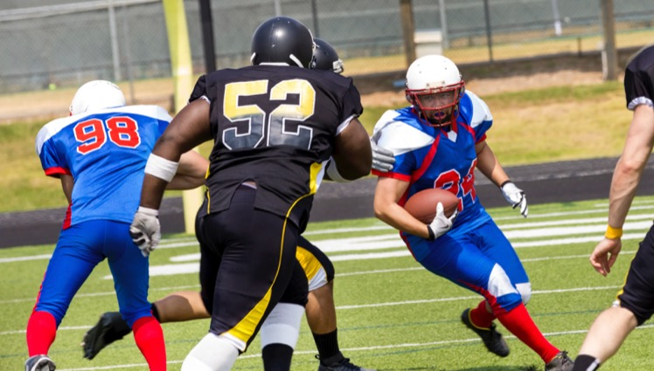
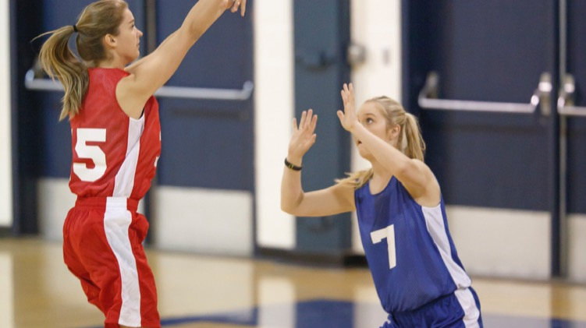

~20G IS RIGHT FOR MOST ATHLETES
~0.25-0.3
g/kg
288 LBS
X 0.25 (g/kg)
135 LBS
X 0.25 (g/kg)
33G PROTEIN
15G PROTEIN
Moore et al. AJCN. 89:161-168, 2009; Witard et al. AJCN. 99:86-95, 2014.
Joint Position Statement: Nutrition and Athletic Performance. Med Sci Sports Exerc. 48:543-68, 2016
Notes:
Based on two different dose-response studies, 20 g is the right amount for most athletes. In these studies athletes were about 180 lbs. The authors extrapolated about 0.25 g/kg

Slide 13
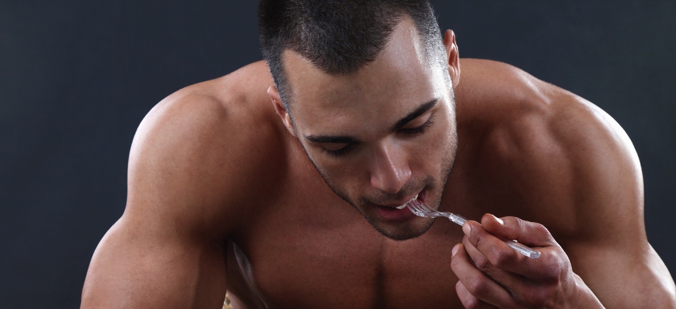
What happens if an athlete consumes more than ~20g?
Slide #10 Chart: Moore et al. AJCN. 89:161-168, 2009; Witard et al. AJCN. 99:86-95, 2014.
Notes:
When more than ~20 g (0.25-0.3 g/kg) of protein is consumed, the excess amino acids are oxidized or excreted. It appears that there is a plateau as to how much protein the muscle can use to support structure at one time.

Slide 14

Eat
~20g
ASAP
Protein-timing post exercise
Notes:
Eat protein as soon as possible after a training session or competition.
You may have heard talk in the popular media about a “recovery window” of about 30-60 min for consuming recovery nutrients. There isn’t good research to support an exact window, so it is beneficial for athletes to consume protein as soon as their stomach will accept the nutrients.
The muscle is sensitive to protein intake for 24 hours post exercise. BUT, the pattern of regular intake is also important, so to achieve higher total amounts at regular intervals, eating shortly after exercise helps to avoid larger intakes later and establishes the pattern

Slide 15
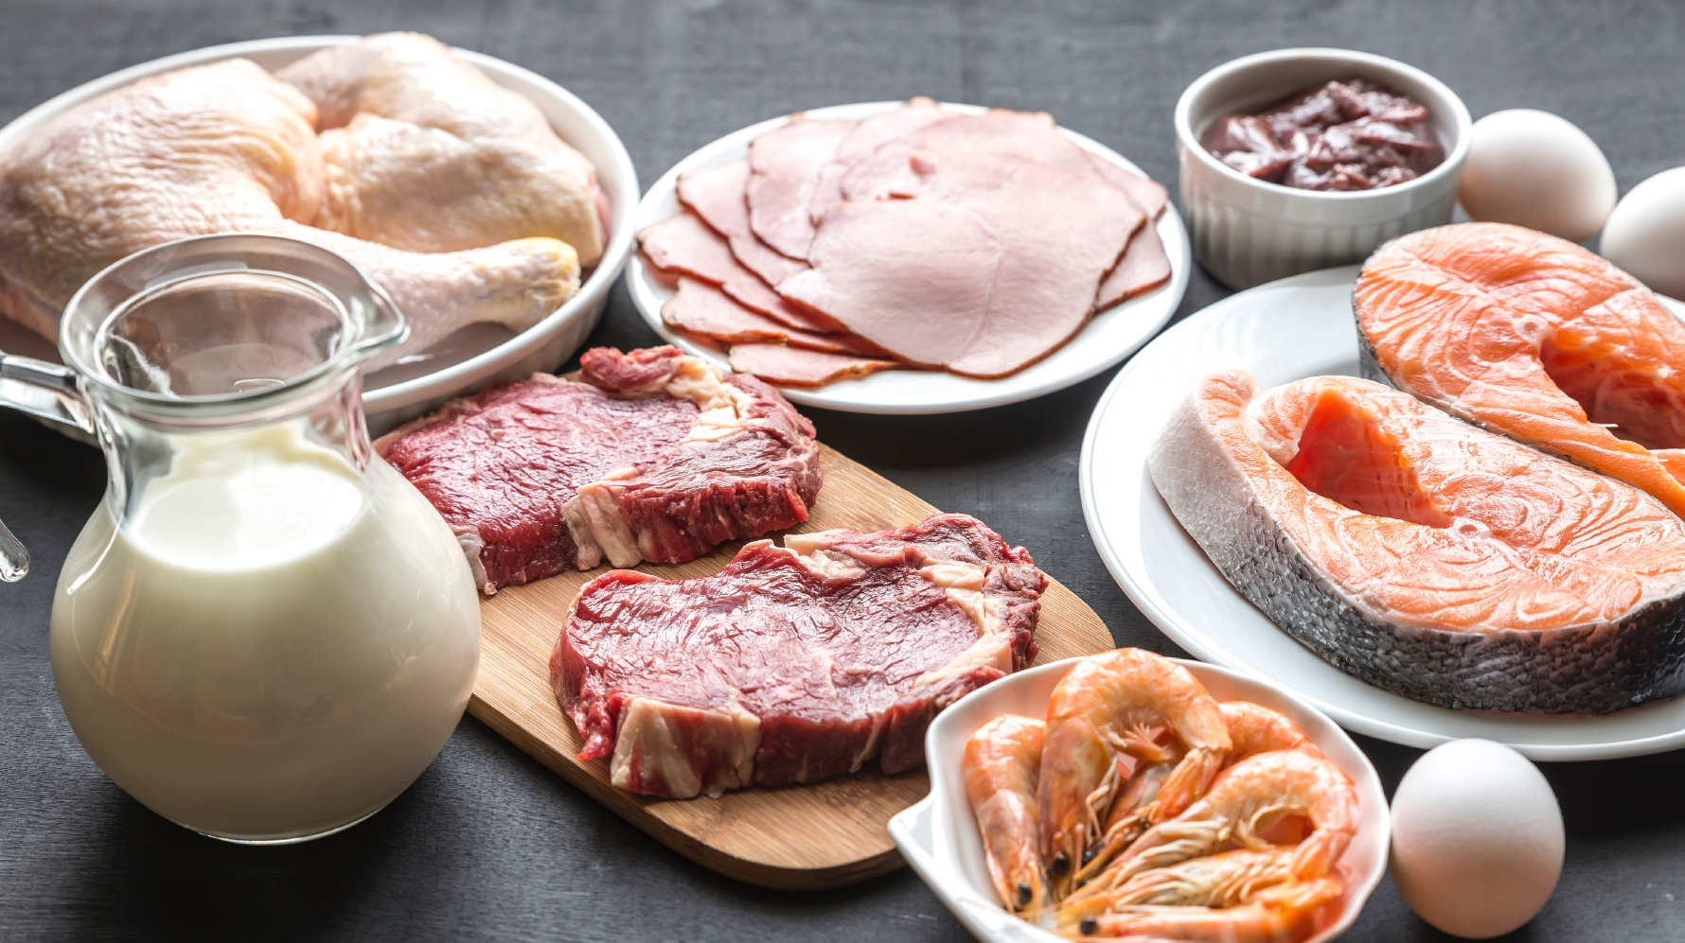
Protein intake pattern
80G
WHEY PROTEIN
1.5 hours
3 hours
6 hours
10g
20g
40g
Moore et al. Nutr & Metab. 9:91, 2012 doi:10.1186/1743-7075-9-91
Notes:
For athletes looking to increase muscle mass, repeated intake after training is beneficial. In a recent study, subjects consumed 80 g whey protein after knee extension exercise; the 80 g was broken up and consumed either as 10 g every 1.5 hours, 20 g every 3 hours or 40 g every 6 hours. 20 g every 3 hours was found to have the most beneficial impact on net protein balance.
Abstract: The pattern of protein intake following exercise may impact whole-body protein turnover and net protein retention. We determined the effects of different protein feeding strategies on protein metabolism in resistance-trained young men.
METHODS:
Participants were randomly assigned to ingest either 80g of whey protein as 8x10g every 1.5h (PULSE; n=8), 4x20g every 3h (intermediate, INT; n=7), or 2x40g every 6h (BOLUS; n=8) after an acute bout of bilateral knee extension exercise (4x10 repetitions at 80% maximal strength). Whole-body protein turnover (Q), synthesis (S), breakdown (B), and net balance (NB) were measured throughout 12h of recovery by a bolus ingestion of [15N]glycine with urinary [15N]ammonia enrichment as the collected end-product.
RESULTS:
PULSE Q rates were greater than BOLUS (~19%, P<0.05) with a trend towards being greater than INT (~9%, P=0.08). Rates of S were 32% and 19% greater and rates of B were 51% and 57% greater for PULSE as compared to INT and BOLUS, respectively (P<0.05), with no difference between INT and BOLUS. There were no statistical differences in NB between groups (P=0.23); however, magnitude-based inferential statistics revealed likely small (mean effect±90%CI; 0.59±0.87) and moderate (0.80±0.91) increases in NB for PULSE and INT compared to BOLUS and possible small increase (0.42±1.00) for INT vs. PULSE.
CONCLUSION:
We conclude that the pattern of ingested protein, and not only the total daily amount, can impact whole-body protein metabolism. Individuals aiming to maximize NB would likely benefit from repeated ingestion of moderate amounts of protein (~20g) at regular intervals (~3h) throughout the day.

Slide 16
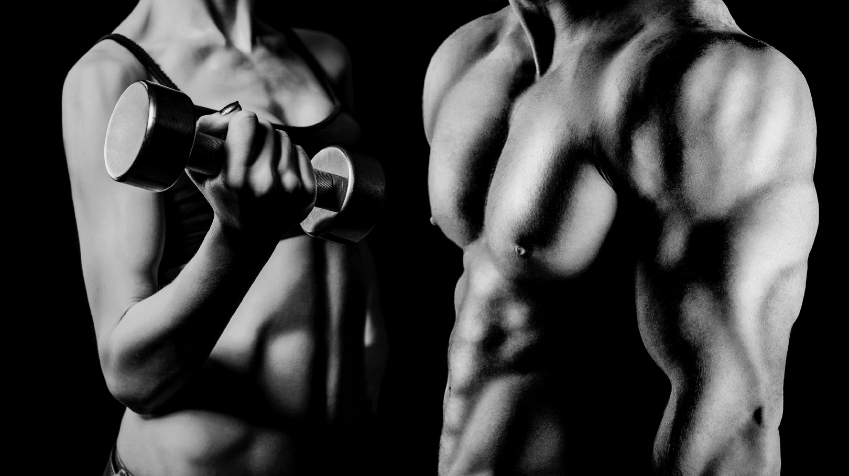


SYNTHESIS
MUSCLE PROTEIN
BREAKDOWN
MUSCLE PROTEIN
BALANCE
PROTEIN
Moore et al. Nutr & Metab. 9:91, 2012 doi:10.1186/1743-7075-9-91
Joint Position Statement: Nutrition and Athletic Performance. Med Sci Sports Exerc. 48:543-68, 2016
Notes:
The researchers then measured muscle protein synthesis, breakdown, and protein balance. After statistically examining the differences betwene the eating patters on these outcomes, the researchers concluded that repeated ingestion of about 20 g of whey protein every 3 hours could help maximize net protein balance

Slide 17

PROTEIN AND SLEEP
CONSUME
~30
~40
TO
OF PROTEIN
Res et al. Med Sci Sports Exerc. 44:1560-1569, 2012.
Snijders et al. J Nutr. 145:1178-1184, 2015.
Trommelen et al. Med Sci Sports Exerc. 48:2517-2525, 2016.
Jager et al. J Int Soc Sports Nutr. 14, 2017.
Notes:
The pattern throughout the day includes before bed. Athletes can also consider eating protein before bed to support recovery.
Eating pre-sleep protein increases overnight MPS and metabolic rate without impacting lipolysis (fat oxidation)

Slide 18

22%
INCREASE
Res et al. Med Sci Sports Exerc. 44:1560-1569, 2012.
Notes:
This is a growing area of research (and we’re still learning more), but in one study, 40 g of casein protein before sleep after an evening resistance training session resulted in 22% increase in muscle protein synthesis.

Slide 19
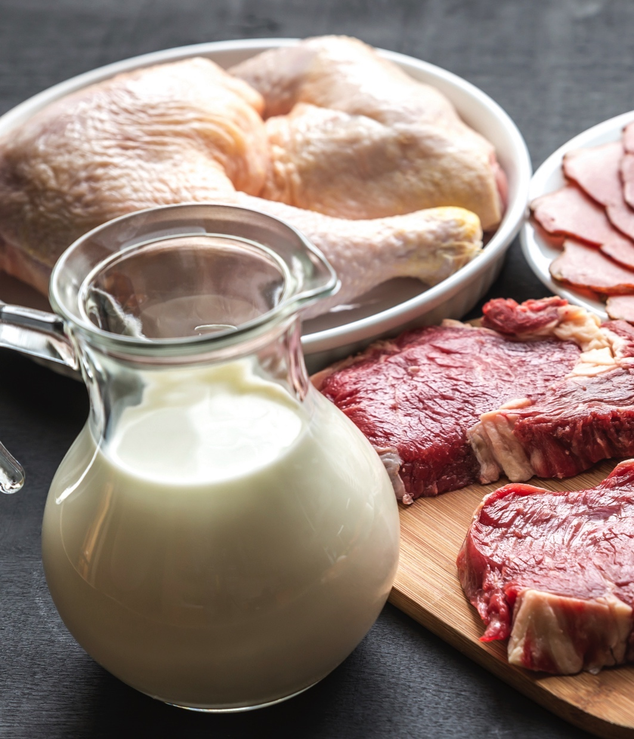

Types of
Protein
1
Complete protein
2
Rapidly digested/absorbed
2
Leucine rich
Philips & van Loon. J Sports Sci. 29:S29-S38, 2011.
Notes:
The ideal protein source for muscle recovery is a complete protein, one that is rich in the essential amino acid leucine, and rapidly digested and absorbed.
Whey and milk protein are suitable here.
Leucine, a building block of protein (essential amino acid), is important since it acts as a signal to initiate the process of muscle protein synthesis.
MILK AND WHEY BEST MEET THESE CRITERIA

Slide 20
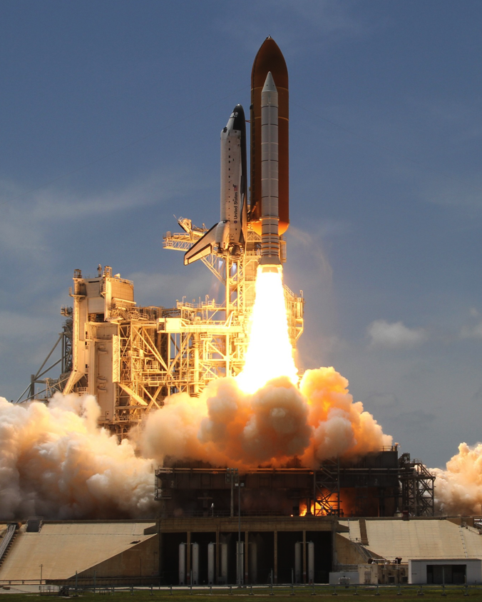
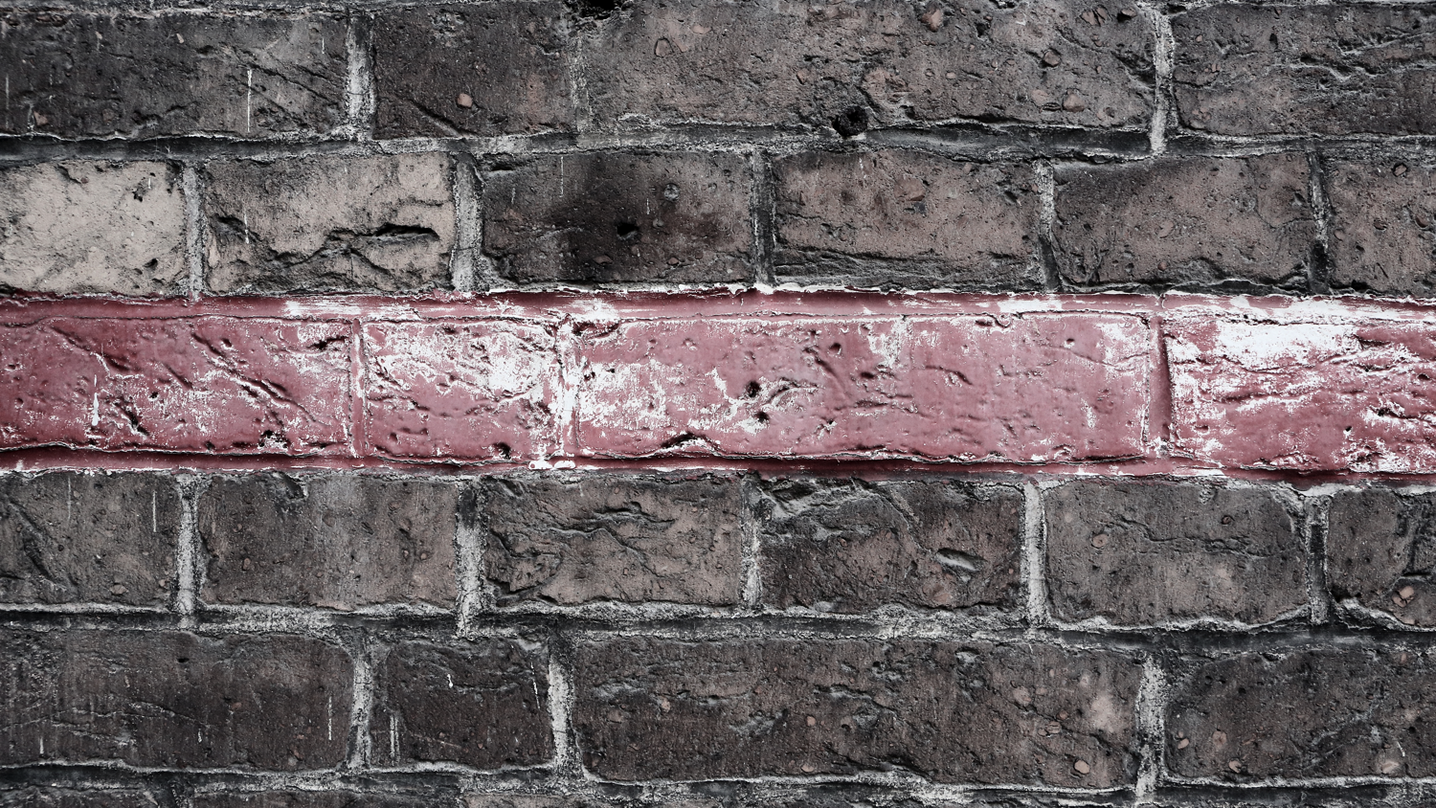
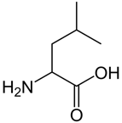
WHY IS
LEUCINE
UNIQUE?
Phillips, S. Sports Science Exchange. (2013) Vol 26, No. 107.
Notes:
Leucine is a special amino acid since it is a building block and also a signal to star, or “ignite” t the process

Slide 21
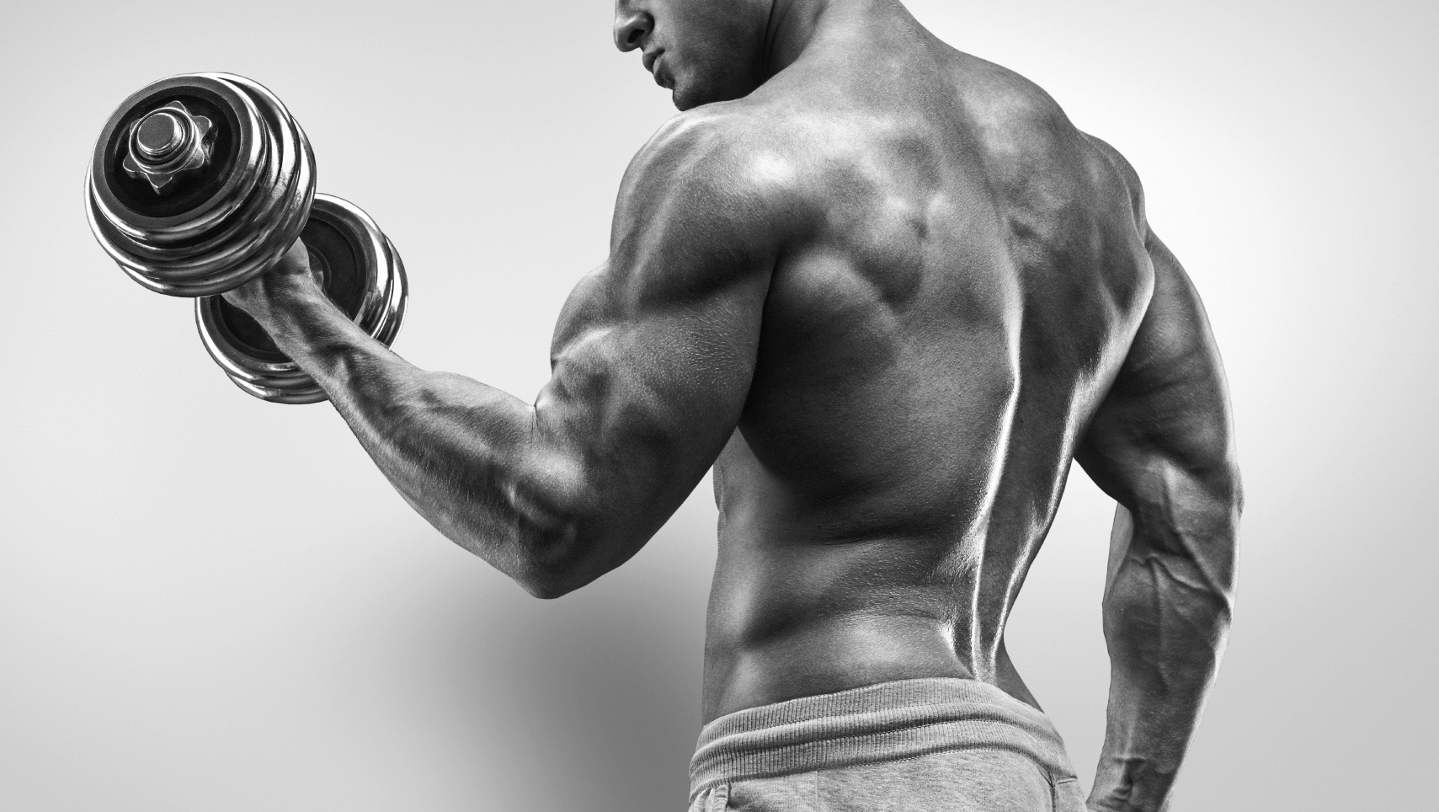



WHEY VS. SOY
.20
.15
.19
.05
.00
REST EX
* 31% > vs Soy
FSR (% -h⁻¹)
WHEY
CASEIN
SOY
Tang et al. J Appl. Physiol. 107(3):987-992, 2009.
Notes:
Studies have been conducted to compare the impact of these different types of protein on both the acute increase in MPS after a bout of exercise. These two graphs are representations, but in several studies milk and whey proteins have been found to be more effective than casein or soy, likely due to their rapid digestion and absorption and rich leucine content
Egg and meat proteins, while high quality protein sources, have not been studied in comparison to the other sources
While in a research lab soy does not perform as well as whey and casein, it's still an option for recovery, especially for a vegetarian athlete

Slide 22
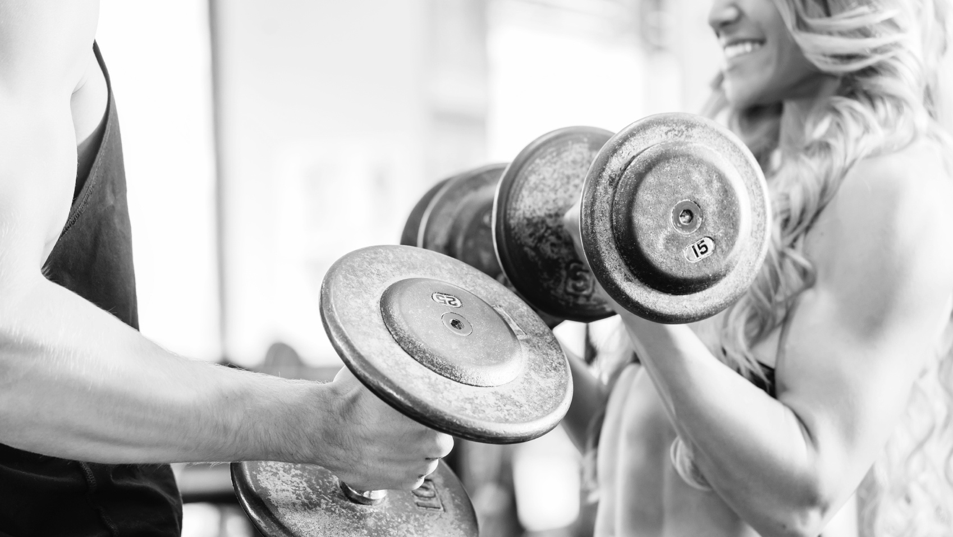

Protein and training: increasing lean mass
4
3
2
1
0
LEAN MASS (KG)
MILK
WHEY
SOY
PLACEBO
Cermak et al. Am J Clin Nutr. 96:1454-1464, 2012.
Phillips et al. J Am Coll Nutr. 28:343-354, 2009.
Notes:
22 different studies that used training programs of at least 6 weeks in healthy individuals, and compared a protein intervention to a placebo control, were analyzed together
Compared to the placebo, post-exercise protein consumption during resistance training in young subjects increased FFM, or the amount of muscle, increased CSA, which is a measure of the size, of type I (slow twitch) & II (fast twitch) muscle fibers, and increased strength measured by 1-RM leg press
And, similar to the results when looking only at the acute response, milk and whey protein most effective as recovery protein sources to gain lean mass

Slide 23

Want to rebuild muscle?
Consume protein strategically.
Notes:
Complete protein sources that are quickly digested and absorbed and rich in Leucine are most effective
The “right amount” is ~20 grams of protein. To be more specific, ~0.25-0.3 grams/kg of body weight.
Protein consumption as soon as possible after exercise is ideal; a regular pattern throughout the day and before sleep are also important

